Slide 1
Chapter 10
Event and Function
Management Accounting techniques

Slide 2
Objectives
After studying this topic you should be able to:
Gain a working knowledge of how the nature of events impacts on the management accounting tools useful in the decision making process;
Develop a working knowledge of management accounting tools that aid event planning, operation, control and performance measurement; and
Understand the usefulness of management accounting in the events sector for management decision making.

Slide 3
Event planning phase management accounting tools
EVENT FINANCIAL PLANNING
FEASIBILITY STUDY
EVALUATE REVENUE POTENTIAL
EVALUATE EVENT COSTS
EVENT BUDGET & FORECAST
MONITOR ACTUAL V. FORECAST
RUN EVENT OR CANCEL / WITHDRAW

Slide 4
Feasibility study
Does the company have the required skills and expertise (or could acquire them) needed to run the event?
Does the event fit with the strategic direction of the company?
Is their time availability in the diary needed for the event (doesn’t clash with planning and running other events)?
Can the event provide a financial return for the company?

Slide 5
Evaluate potential revenue and costs
Look at previous similar events as a guide
In addition to pricing strategies from earlier chapters – consider ‘Purple Book’ (HSE 1999) guidelines e.g. round prices to avoid giving change to reduce entrance queues if cash sales allowed.
Consider relationship of costs to revenue, may be using target costing to control costs.

Slide 6
Event budget and forecast
Budgeting is covered in detail in previous chapter.
Forecasting is shorter term and tactical closer to the event and allows practical adjustments to be made.

Slide 7
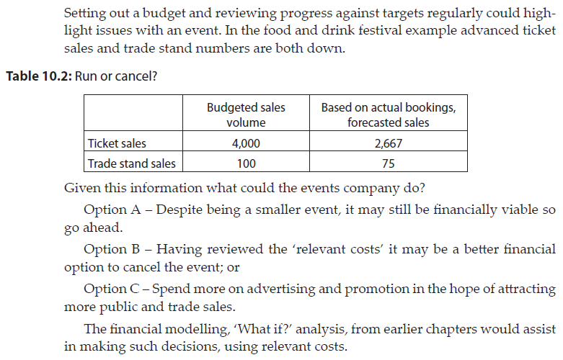
Run, cancel or withdraw from the event?

Slide 8
Management accounting tools for use during the event
MANAGEMENT ACCOUNTING DURING EVENT
COST CONTROL
CASH CONTROL
CONTINGENCY PLANNING
CONSTANT REVIEW
BEFORE EVENT ENDS, FUTURE EVENT PLANS
REVENUE CONTROL

Slide 9
Revenue, cost and cash control
Preparation is one thing, but during the event taking place sound mechanisms for monitoring and controlling all aspects of the event that have financial implications.
Such control can ensure managers are responsive and can adapt to needs as the event progresses to maximise returns.
Constant review is key
Use the opportunity to learn and maximise returns for future events.

Slide 10
Post-Event performance review management accounting tools
POST-EVENT FINANCIAL PERFORMANCE REVIEW
REVENUE REVIEW
COST REVIEW
PROFIT (SURPLUS) REVIEW
FINANCIAL PERFORMANCE INTERNAL BENCHMARKS
FINANCIAL PERFORMANCE EXTERNAL BENCHMARKS
LEARN FOR FUTURE EVENTS

Slide 11
Review and the future
Review all elements of the event
Compare to internal benchmarks (budget and past events)
Compare to external benchmarks (competitor and industry data)
Learn for the future (explained on next slide)

Slide 12
Learn for future events
EVENT OPERATION
ADVANCE PLANNING
POST EVENT ANALYSIS

Slide 13
Summary
Events allow the opportunity to consider an event as an ‘activity’ for planning and control purposes.
In the event planning phase it is important to fully evaluate potential revenue alongside the associated costs to produce an event budget.
During an event it is important to closely monitor all aspects that could impact on the financial returns of the event and not just wait post-event analysis.
Review post-event is essential to learn from the event to plan ahead for future events.

